Slide 1
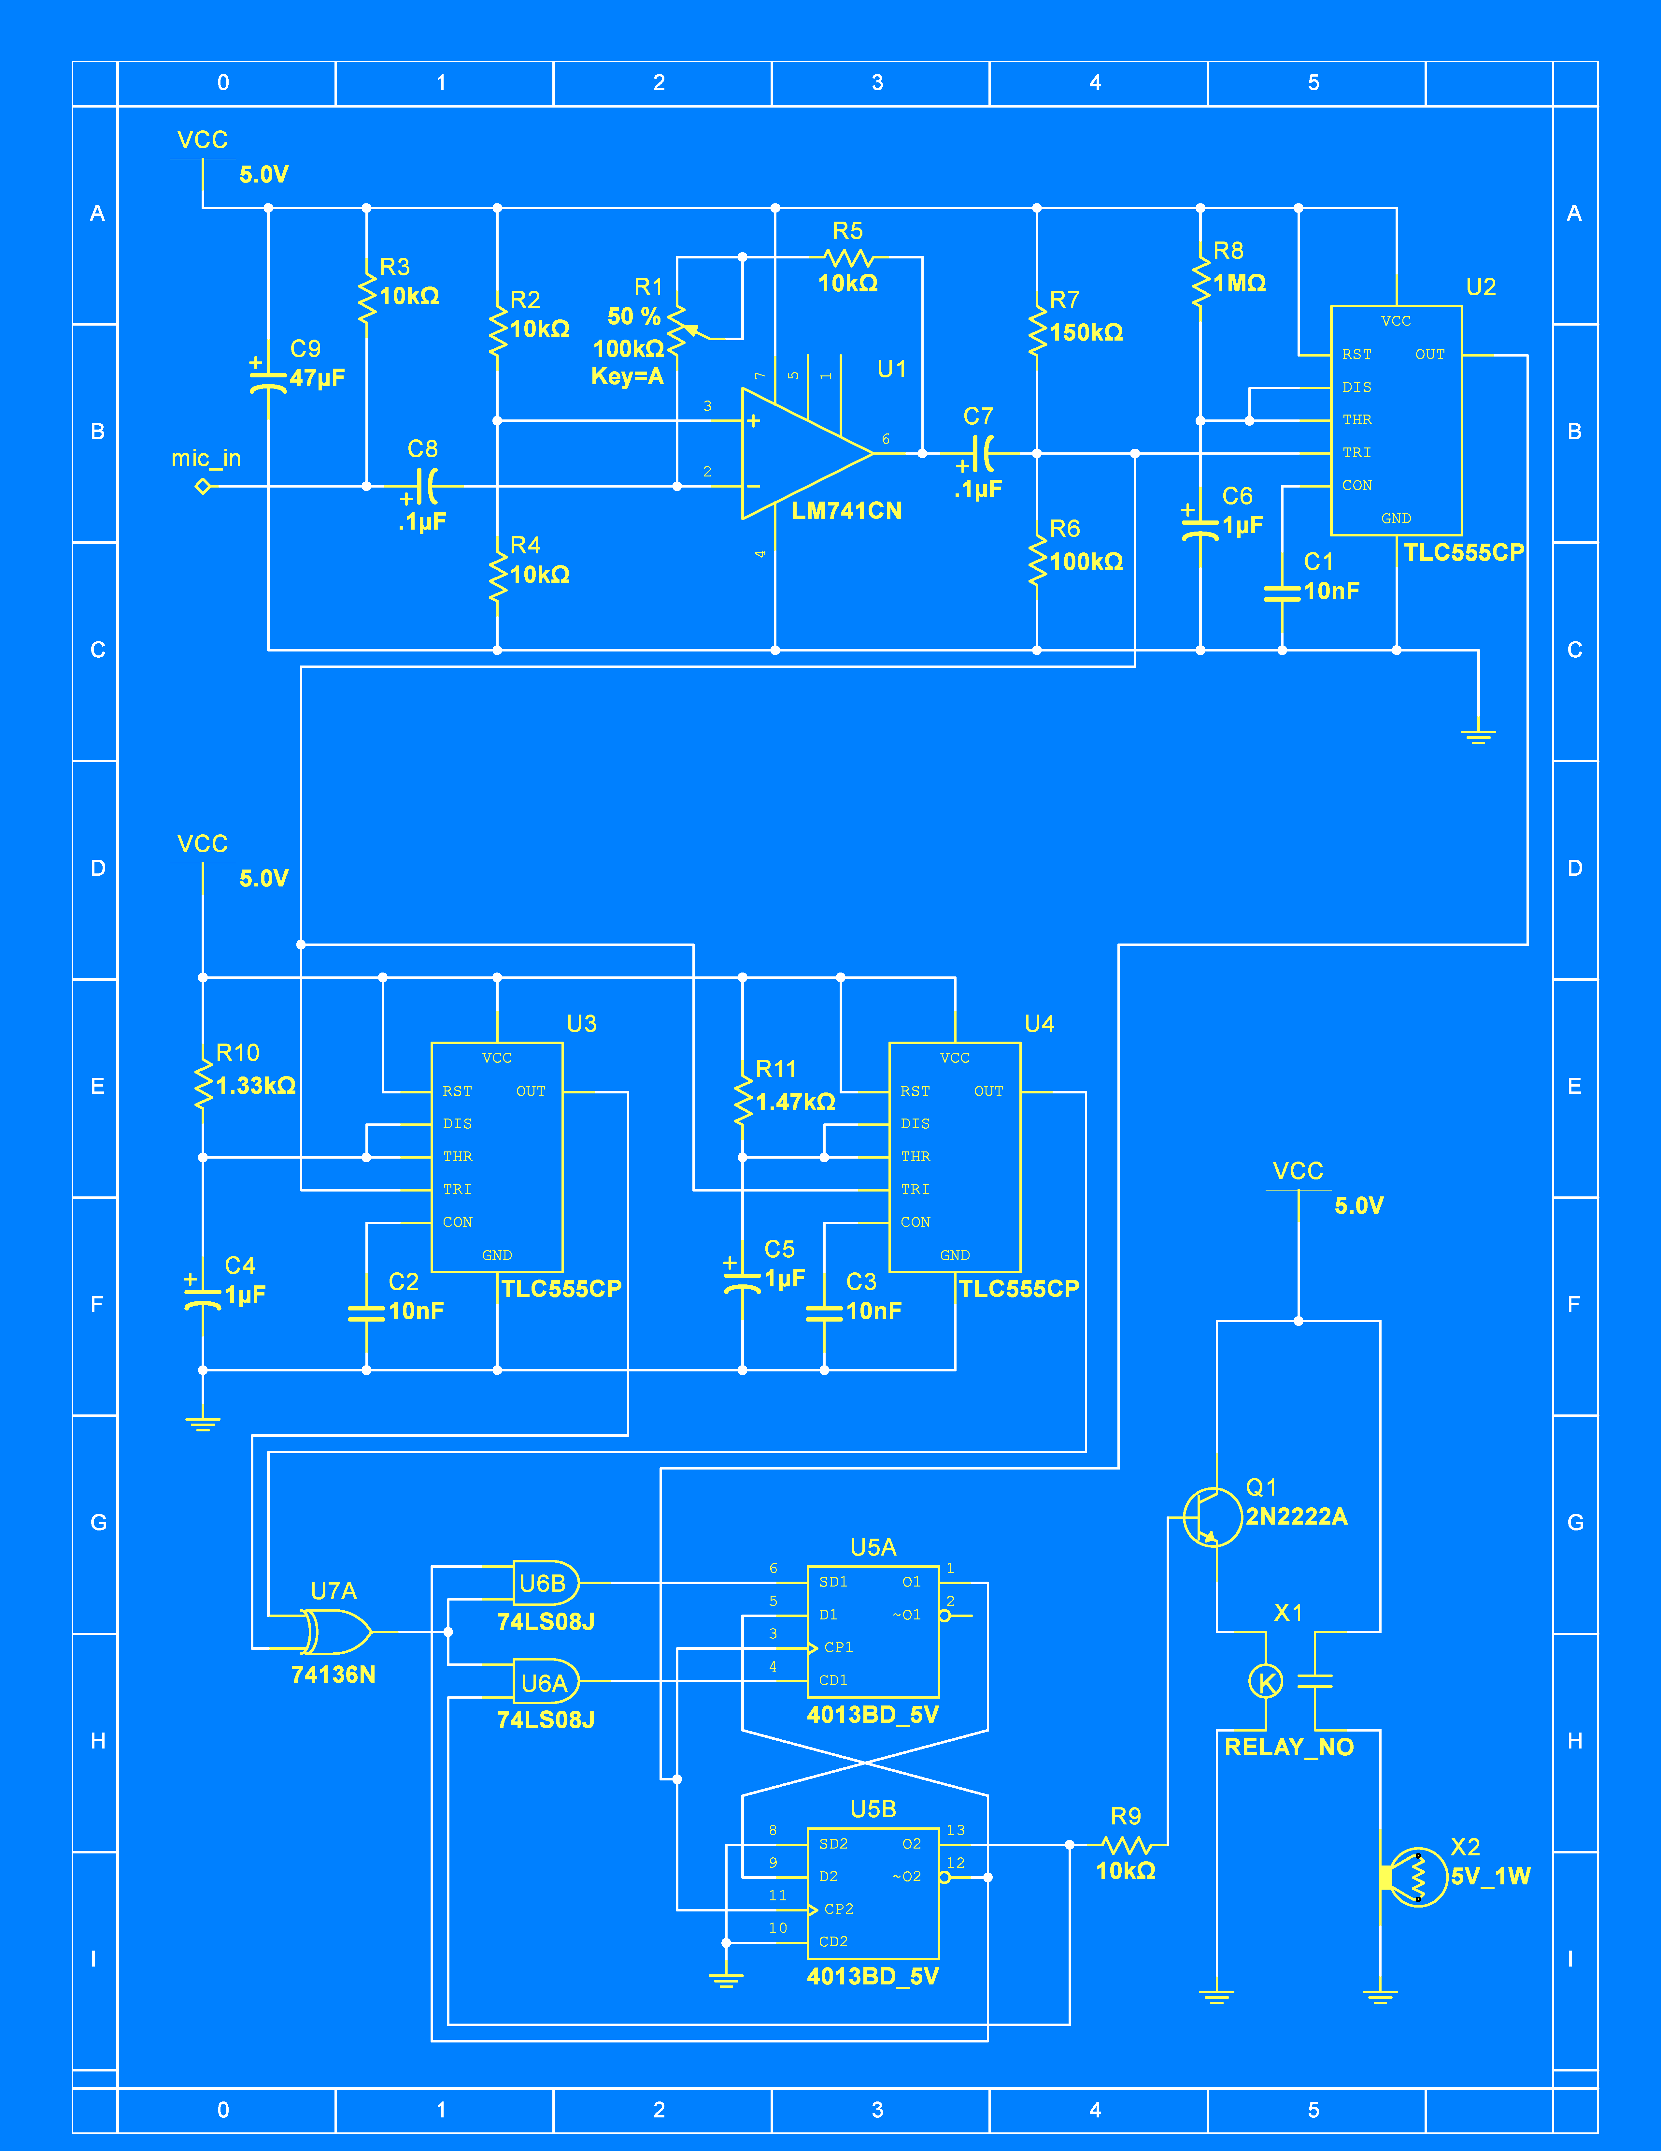
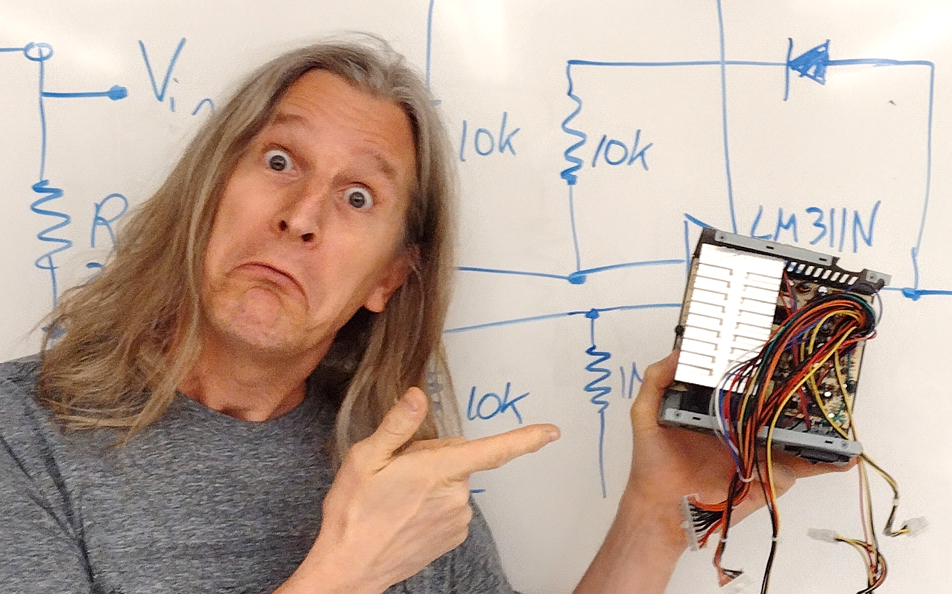
Electronics For Doing!
Laboratory Exercises for Physics 216

